Slide 1
Measuring the Loss of Wealth
in Asheville
Group 4:
Xander Smead, Yicheng Wang, Daniel Rong, Zhaojie Yin, Anna Kafrune

Slide 2
Background on Urban Renewal
Took place from 60’s-90’s
East Riverside was the neighborhood most heavily affected by the urban renewal projects
This neighborhood housed more than 50% of the city's African American residents
The city of Asheville used the power of eminent domain to uproot African American families and businesses, taking away homeownership, and affecting generational wealth
Notes:
Power of eminent domain:power of the government to take private property and convert it into public use. The Fifth Amendment provides that the government may only exercise this power if they provide just compensation to the property owners.

Slide 3
Methods that we used
We used QGIS to match up the parcel division map from the 60’s with a map of the parcels how they are today. With this we were able to tell how the individual parcels from the 60’s were combined into larger parcels today and could compare the values that way.
We collected metadata about the parcels such as their appraisal rates in order to use that information for our interest calculations
We coded a calculator using python that took each properties value from the 60’s and calculated the value that it would have today based on inflation rates.

Slide 4
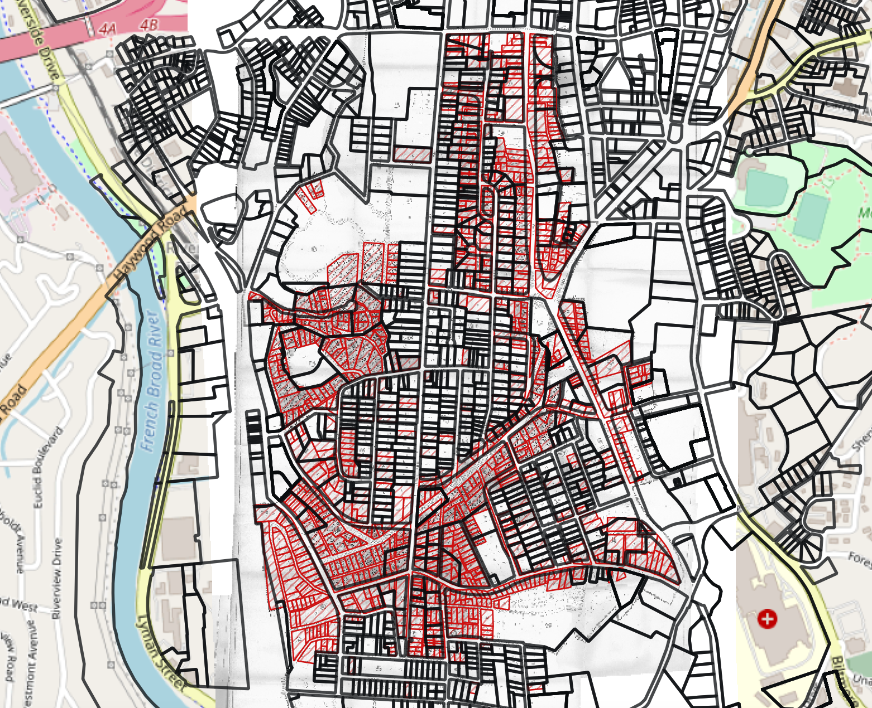
QGIS
This is the entire map containing the data we have for the whole city of Asheville. The yellow circle shows block 4, the part that we have been worked with.
Our methods could, potentially, be reproduced for the rest of the city to calculate the stolen wealth from every single property that was repossessed.

Slide 5
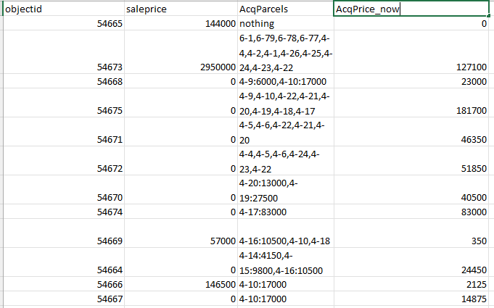
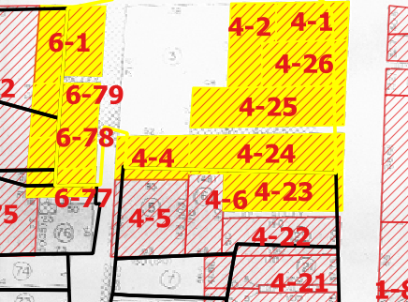
QGIS
Notes:
First we focused on finding out how the parcels in the Asheville today match those from the 1960s and calculated the value of each parcel back to 1960.
For the overlapping parts, we calculate the approximate value based on the ratio of the area

Slide 6
QGIS
object_id | Parcel Collection | Price_60s | Price_nowadays | Value Growth Ratio
54664 | 4-14，4-15，4-16 | 24,450 | 251,200 | 1027%
54674 | 4-17 | 83,000 | 1,292,900 | 1557%
54667 | 4-10 | 17,000 | 74,500 | 438%
Here are some tables comparing the values of the selected parcels nowadays with those of the 1960s.

Slide 7
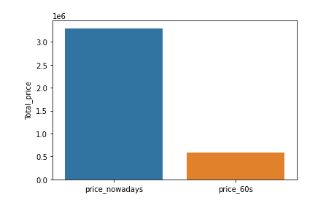
QGIS
This illustrates the change in value across block 4. We can see that the value appreciation is close to 4 times as much

Slide 8
Background on Data
Most documents are official city files.
60 scanned pages from Block 53-Parcel 1, which covers 9 buildings in total (1 business and 17 families)
Rental agreements, establishment of rental charges, deeds, claims for relocation payments, descriptions of improvements property inspections, and photos
Scanned Map
Significance: Documentation that proves the relocation of a large number of Asheville citizens from their homes.

Slide 9
Data
Block number
Parcel number
Money
Appraisal year
Event id, parcel id, type id, person id
Response
Name
Land use
Street name

Slide 10
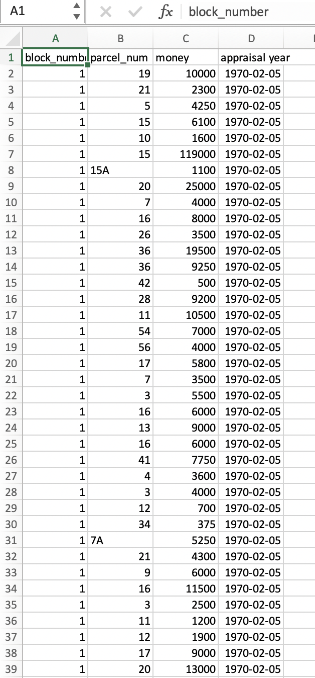
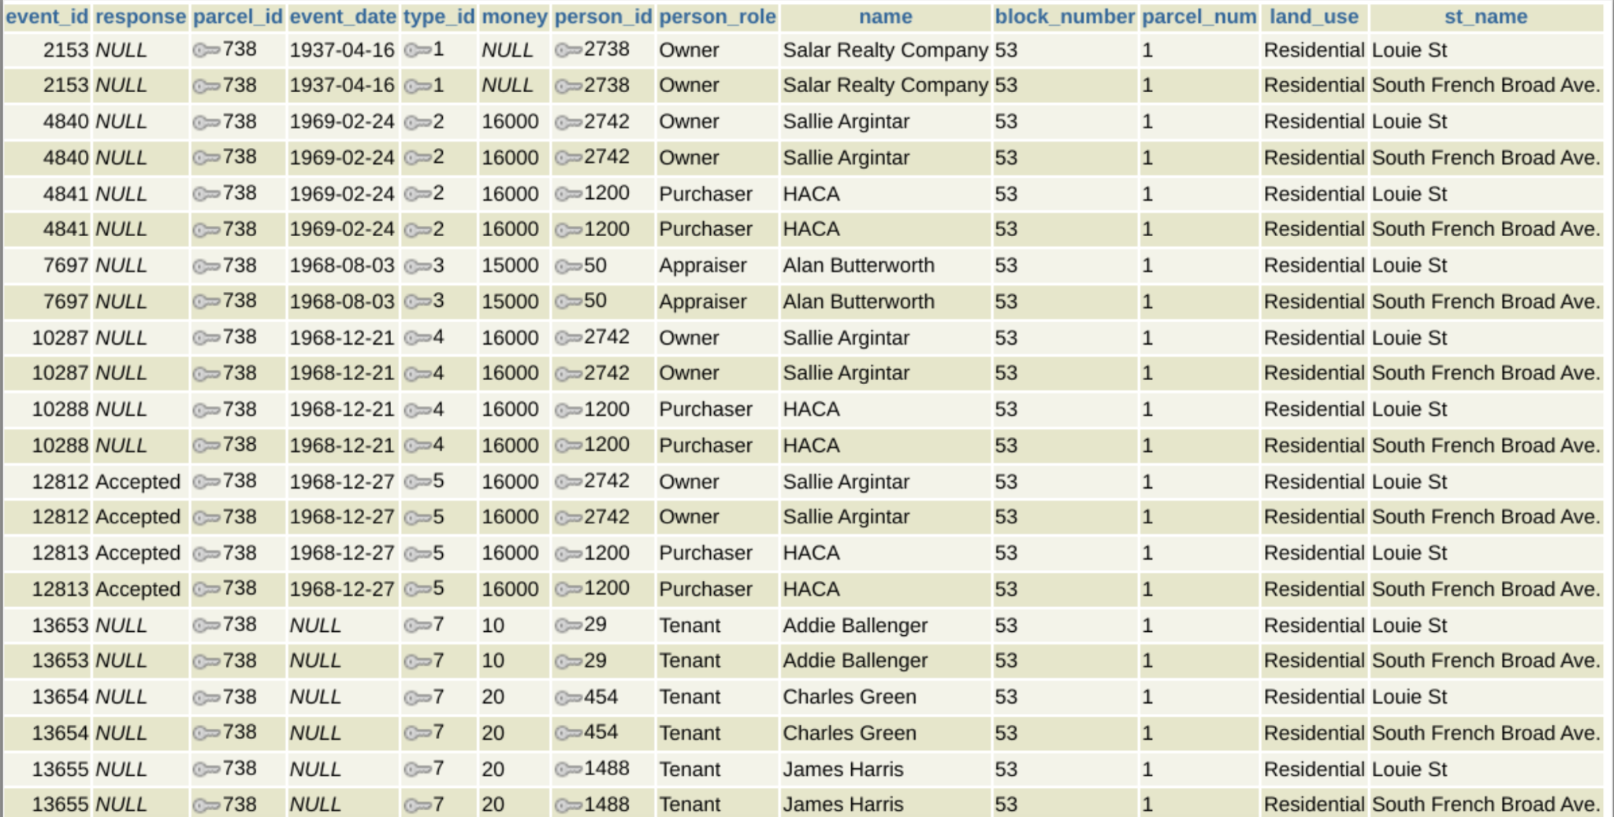
Examples of how we collect our data

Slide 11
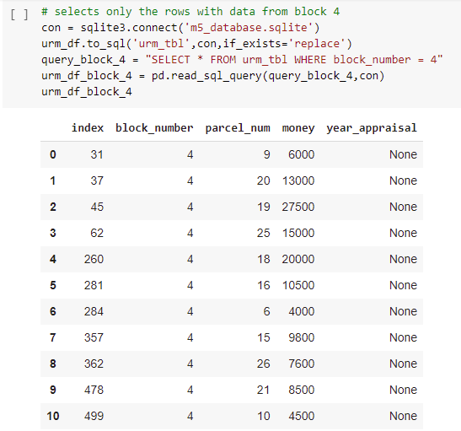
Calculator
Block 4 data

Slide 12
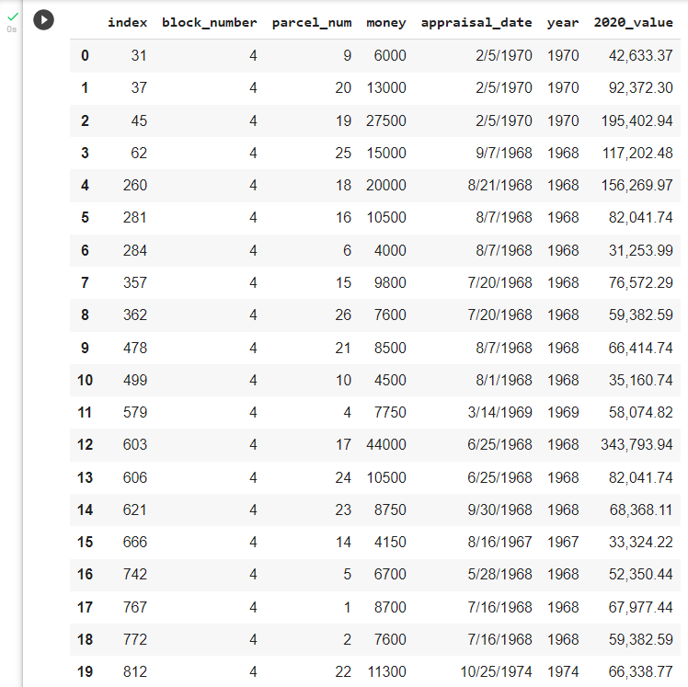
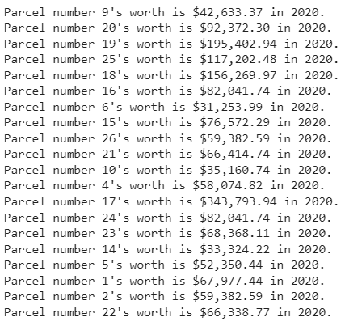
Calculator
Uses the yearly inflation in the US to calculate what the properties’ appraisal value would be in 2020.
Notes:
Anna: Based on the possibilities of calculation methods and the available data, we decided to program a calculator that uses the yearly inflation in the US. What we get from it is a way to calculate what the properties’ appraisal value that were determined since around the 1960s would be in 2020. You can see the change from the appraisal value to the 2020’s value highlighted in the dataframe on the right.
But why create our own calculator? We did have options of existing online calculators to use, such as the one on Measuringworth website, which provides an expected value for each property’s current worth in today’s dollar. However, our calculator allows for a more efficient process of calculation for our project and provides results for the current worth of the properties based on the properties’ individualities.

Slide 13
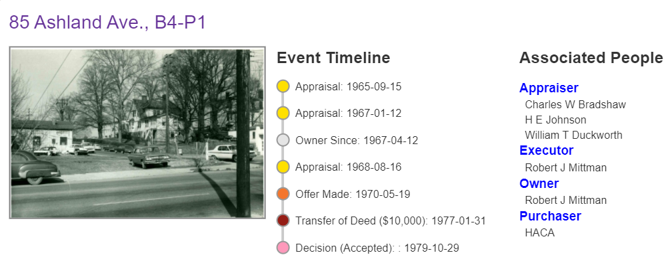
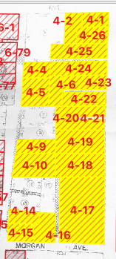
appraised what it would
value be in 2020
Notes:
Anna:
Here is a closer look on one of the properties in block four. On the left, there is the map of block 4. In the center there is a picture of the property and the timeline of events related to the properties’ appraisal and transfer and the people involved in this process. And below, there is the appraisal value, date, and the 2020 value we calculated.
Parcel 1, in 85 Ashland Avenue, was owed by Robert J. Mittman and appraised at 8,700 dollars in 1969 and the property value in 2020 would be around 67,977 dollars.

Slide 14
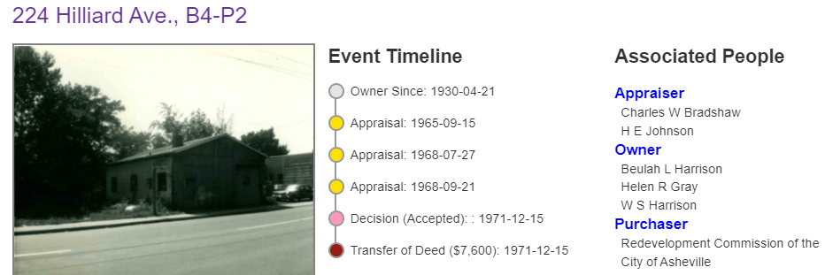
appraised what it would
value be in 2020
Notes:
Anna:
Parcel 2, in 224 Hilliard Avenue, was owed by the Harrison and Gray families and appraised at 7,600 dollars in 1968 and the property value in 2020 would be around 59,382 dollars.

Slide 15
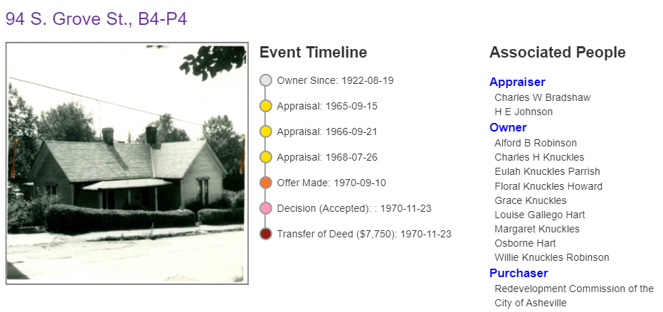
appraised what it would
value be in 2020
Notes:
Anna:
Parcel 3, in 94 S. Grove Street, was owed by the Knuckles, Robinson, and Hart families and appraised at 7,750 dollars in 1969 and the property value in 2020 would be around 58,074 dollars.
(One future development that could be made is gathering data on other appraisal points in the properties’ histories, such as when the government sold them to evaluate the extent of the change that had already happened in this shorter period of time.)

Slide 16
Theoretical future use
Comparing the differences between old and new parcel data
Assembling all our findings into a Google Colab notebook
Comparing how much Asheville paid
Look into other factors to better approximate property appreciation

Slide 17
Impact of Urban Renewal
Urban renewal is not exclusive to Asheville
It is a method that has been used by other cities to take property, disproportionately from African American communities
This is just one example of systemic racism
It is important to recognize and reflect on injustices of the past in order to progress

Slide 18
Thank you!

